Slide 1


Analyzing Beer Preferences
Team Members: Rob Stewart, Shenglin Ye, Shamil Tajuddin, Xiaoran Chen

Slide 2
Analyzing Beer Preferences
1
2
3
4
5
Overview
Do preferences change by beer style?
What data source did we use to help answer our question?
data scrub
Dropped rows with missing data
Timestamp conversion
Data integrity checks
understanding
Get familiar with dataset by use of the following:
-special case dataframes
-groupby
-bar/ line charts, binning
Deep dive
Multiple Linear Regression
-Overall Ratings
-American IPA
-Fruit Beer
Conclusion?
Per Regression analyses, are our hypotheses correct?
Other interesting findings?

Slide 3
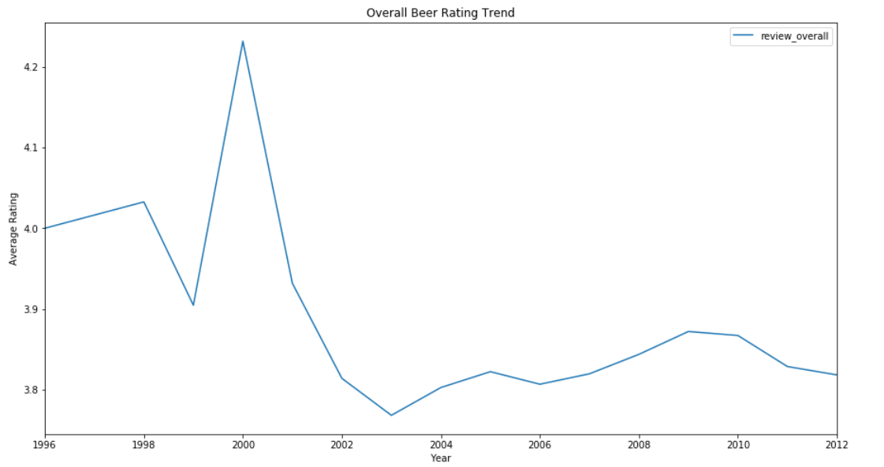
Understanding Data—Beer Rating Trend(1)

Slide 4
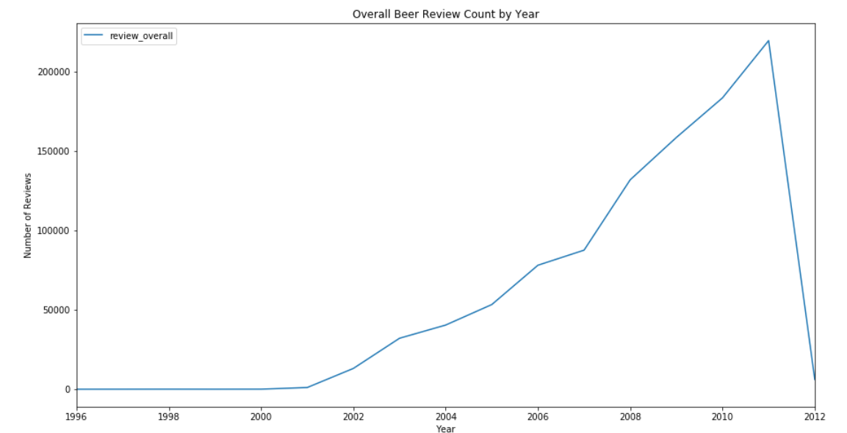
Understanding Data—Beer Rating Trend(2)

Slide 5
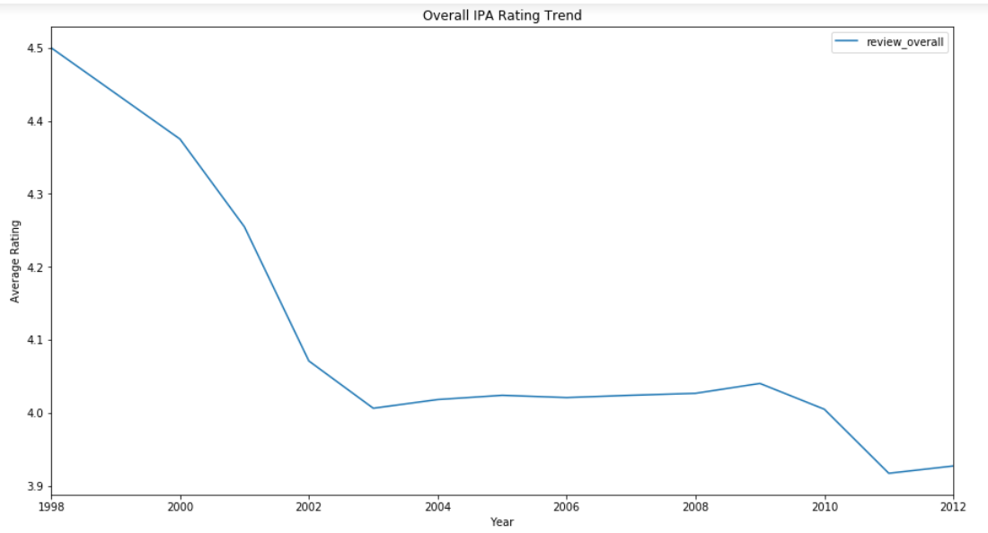
Understanding Data—Beer Rating Trend(3)

Slide 6
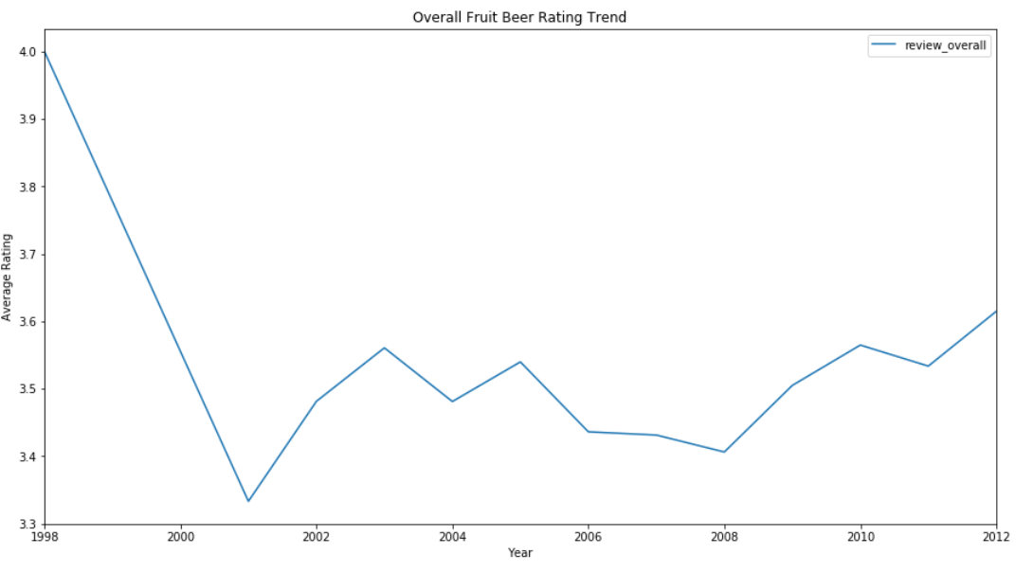
Understanding Data—Beer Rating Trend(4)

Slide 7
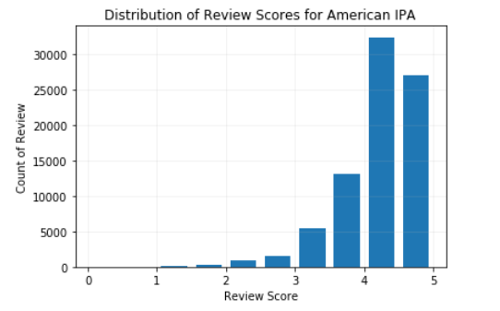
Deep Dive

Slide 8
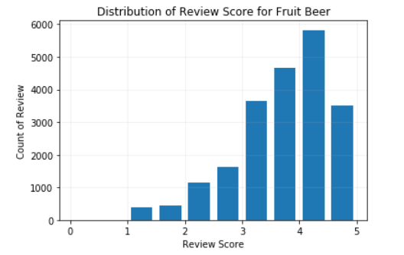
Deep Dive

Slide 9
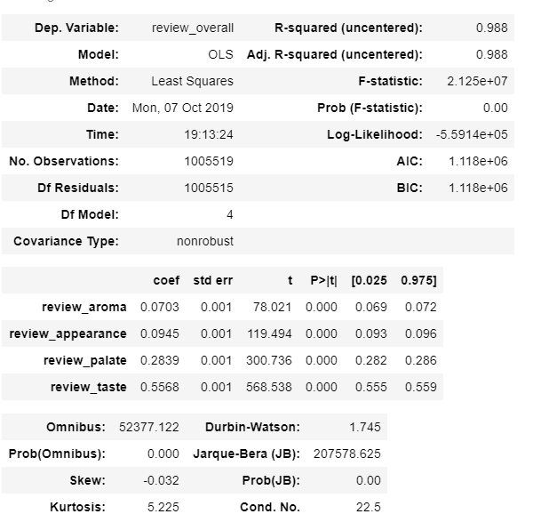
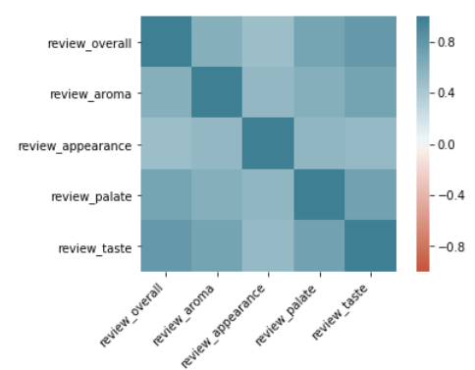
Deep Dive
Regression on full population

Slide 10
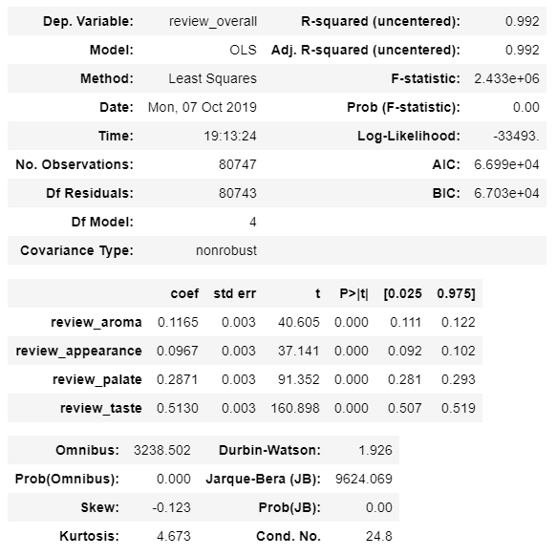
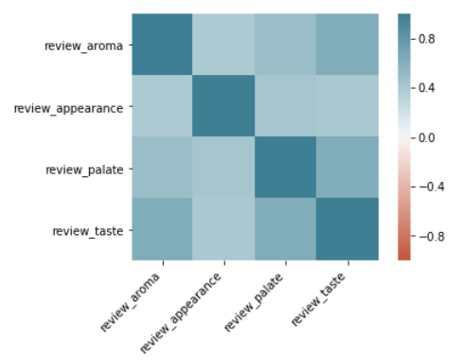
Deep Dive
Regression on American IPA

Slide 11
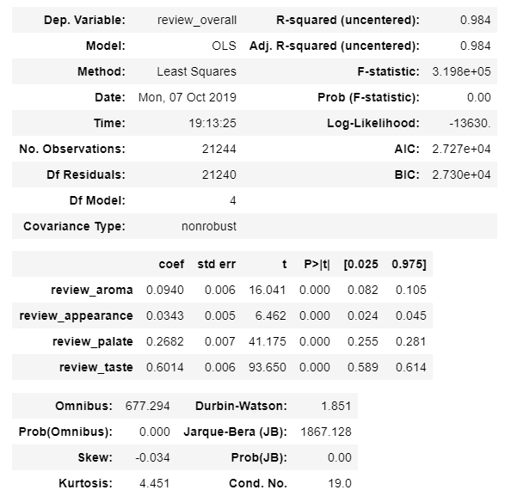
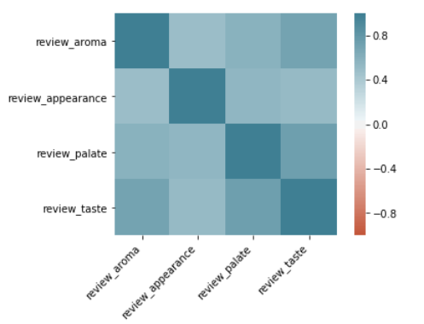
Deep Dive
Regression of Fruit/Vegetable Beer

